Slide 1
Team Dream
Ryan Karlovsky
Callie Houlihan
Bryce Benedict
Matt Keeley

Slide 2
Identify and Define the Problem
A new company named Spyn came to us requesting that we construct an autonomous car to transport elderly people to doctor appointments.

Slide 3
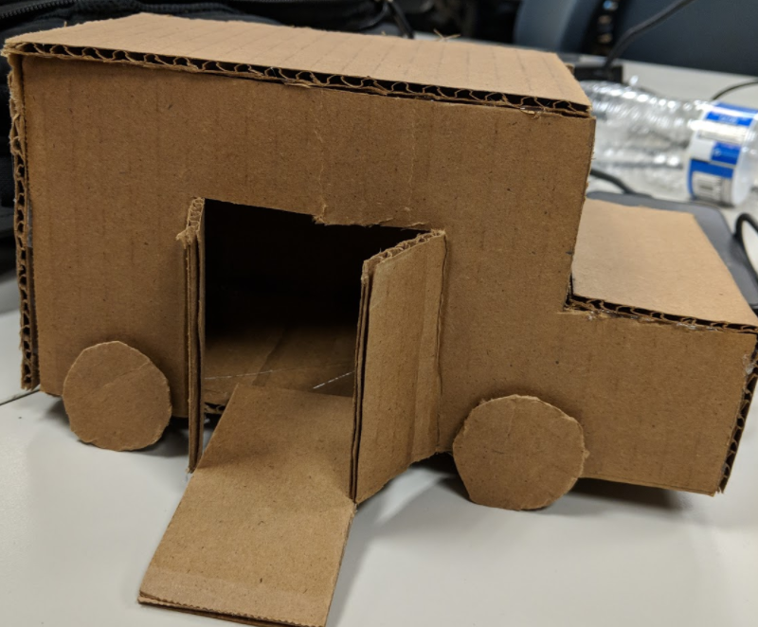
Original Design

Slide 4
Original Design
Our original design was a box car with a ram for the lift with no windows.
Our team thought this was the most efficient design since the car was big enough to transport a wheelchair.
We did not leave very much room for any errors that could have arised.
We decided to use four wheels since most cars on the road have four wheels and it would cover ground faster.

Slide 5
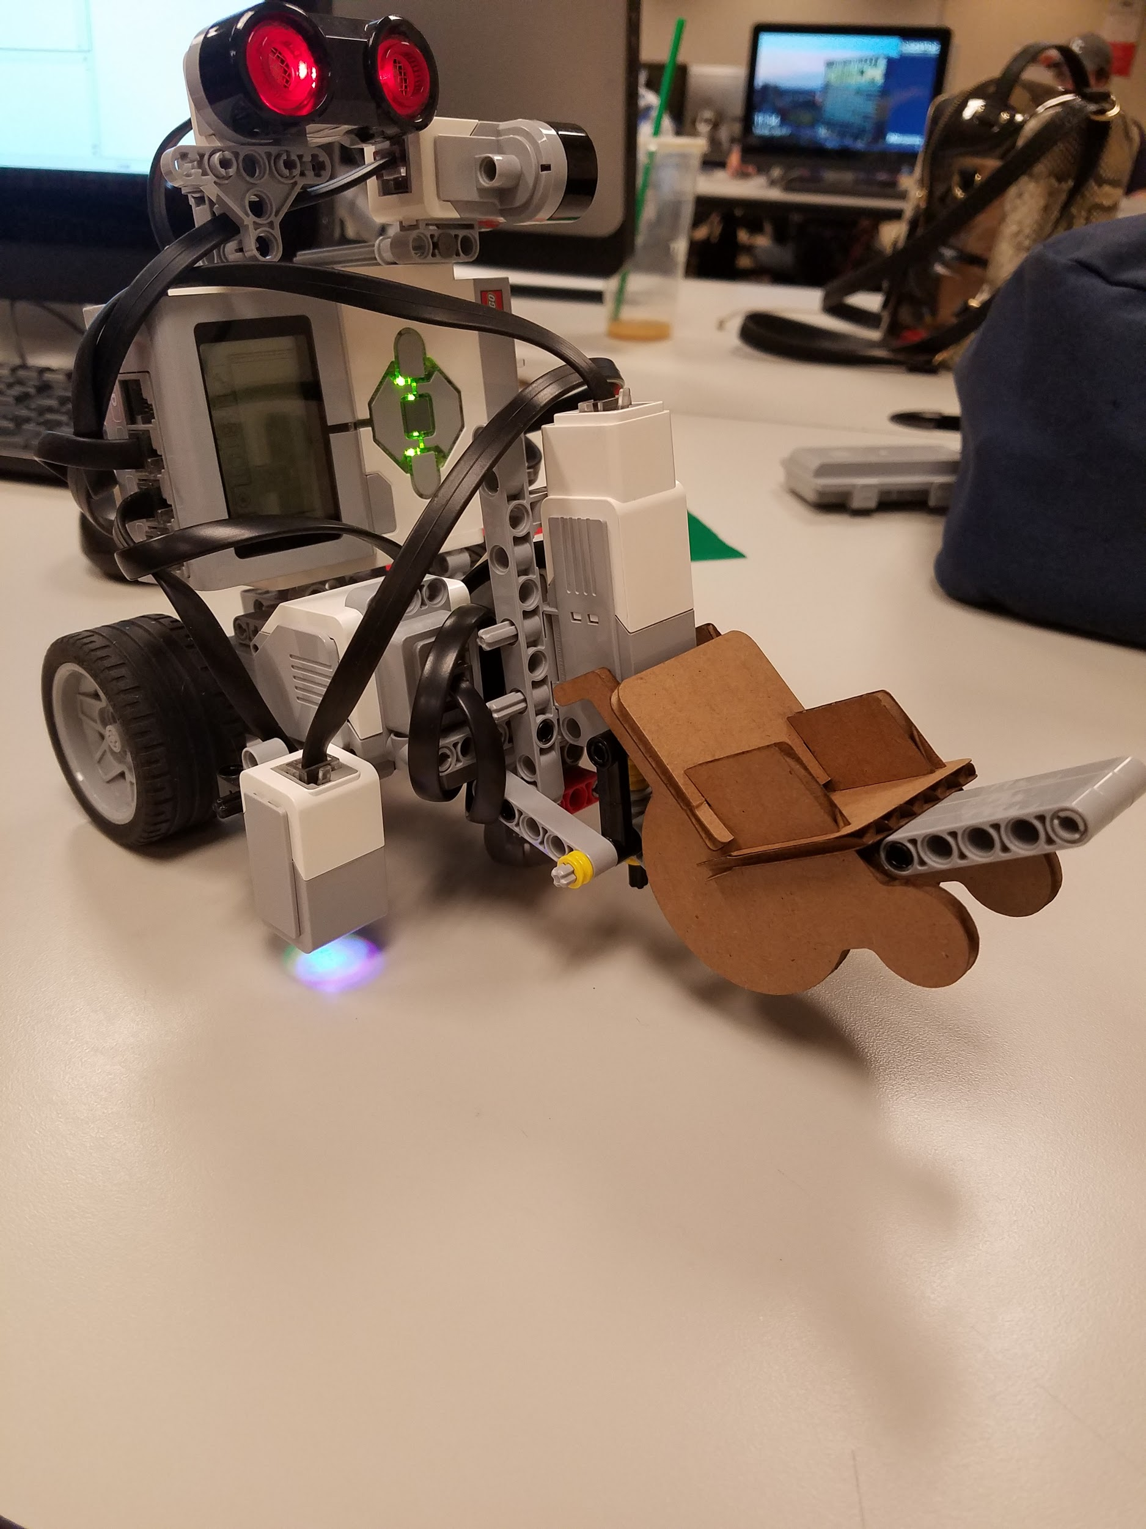
New Design

Slide 6
New Design- Selection and Analyzation
Our team transitioned from a ramp lift to a forklift type lift.
The group decided this would most efficient and would not cause errors.
We transitioned the vehicle from a four wheel concept to a two wheel concept.
We added a marble to the front for better stability and more control over the vehicle.
We added two ultrasonic sensors, one facing forward and one facing left.
We added a color sensor about an inch from the ground for optimal color reading.

Slide 7
Lift - Details
Our team decided to use a forklift rather than ramp.
The forklift allowed us to have better control over the passenger.
The forklift method locked in the passenger so he could not move while the vehicle was in motion.
The forklift method assisted us in safely picking up and dropping off the passengers at the designated pick up and drop off locations.
Using a single motor, it was the most compact and simple solution we thought of, with the extra benefit of being easy to program.

Slide 8
Research Process
The majority of our groups time was spent researching Matlab programming functions.
Our team had members with little to no Matlab programming experience.
The teams overall programming experience was knowledgeable so it was easy to overcome and adapt to Matlab's syntax.
We also went into details on the sensors since each one does something different and had to figure out which ones worked well for our design.

Slide 9
What we researched
The ultrasonic sensor was something we looked into and it benefited us by helping us with our algorithm.
Gyro sensor was something we looked up to see how accurate the 90 degree turns would become, but in the end we did not keep this sensor.
Research for the motors was essential due to them having such a big contribution to the vehicle's performance.
The motors were something that had to be precise since we were using two different ones and had to get them in sync with one another.

Slide 10
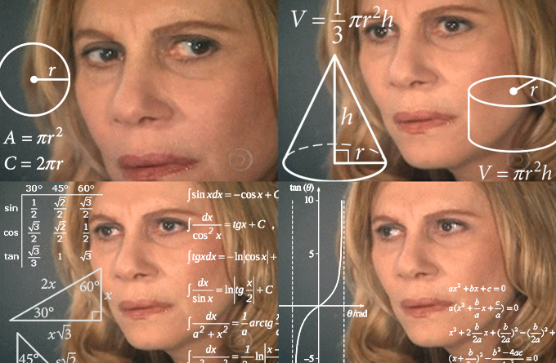
Algorithm

Slide 11
Algorithm
Our team used the left hand algorithm to solve the maze.
We used this to navigate the maze and to autonomously guide the vehicle to the pickup and drop off locations.
Using the left hand algorithm made it easy to program the vehicle to be autonomous, and saved us time to fix any bugs that we came across.
Using this algorithm takes a little longer to navigate the maze but our priority was getting the passengers from point A to point B safely.

Slide 12

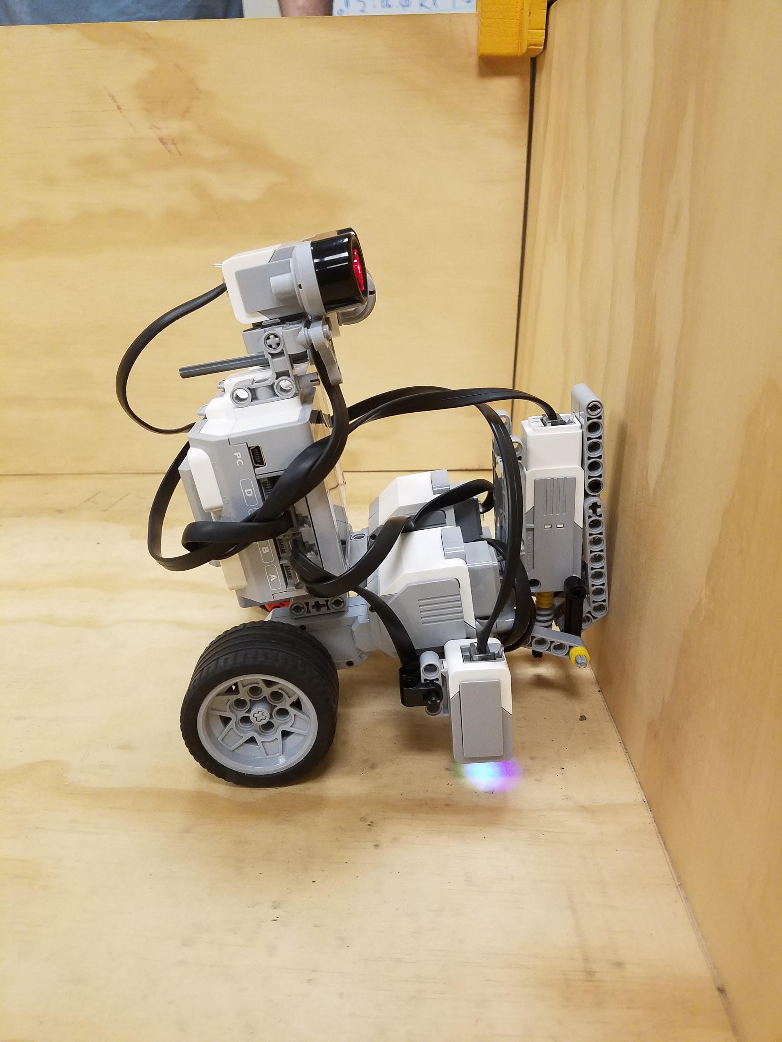
Obstacles

Slide 13
Obstacles
Our team ran into multiple problems throughout the process of designing an autonomous vehicle.
Obtaining a perfect 90 degree turn took up a huge portion of our programming and debugging time.
Using MATLAB was a big challenge since it took us a while to figure out how to program using the MATLAB syntax.
A big issue we ran into was when our vehicle would autonomously run into walls at the start due to programing errors and sensors not reading correctly.

Slide 14
Implementation and Testing
We tested our left hand navigation method.
We tested both the front and the left ultrasonic sensors to calculate a suitable distance to keep the car from the wall for easier maneuvering and safety.
Using the color sensor to observe the red, blue and green strips in order to safely navigate with the passenger aboard.
Testing the gyro sensor to do 90 degree turn was almost impossible, so we scrapped that from the final model.
The touch sensor was useful during testing but we removed it after we found out that the ultrasonic sensor was more effective.
Notes:
Looks beautiful

